Slide 1

E- Learning Platform
Abdukholik Tukhtamishev
Otajon Yuldashev

Slide 2
Introduction
Purpose : Simplify interaction between students and teachers in online education
Key features: Managing posts , grades, calendar and resources search.
Role based access: Students and teachers have tailored functionalities.
SQL: SQLite Database management
Libraries used in Python: Streamlit, datatime, SQLite3, OS, Pathlib, Webbrowser,

Slide 3
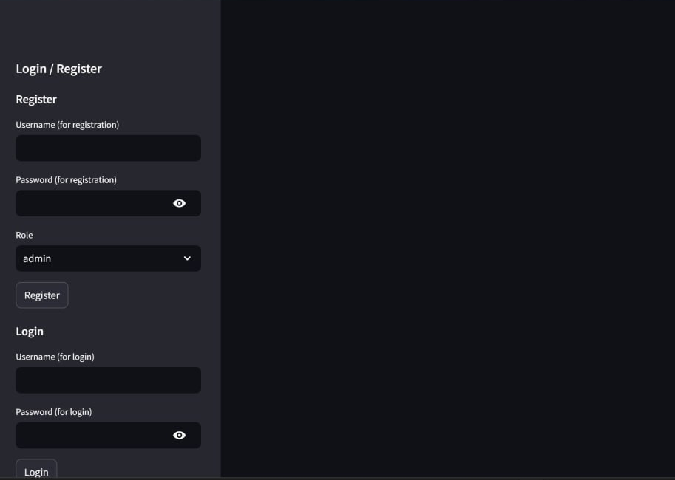
Login page

Slide 4
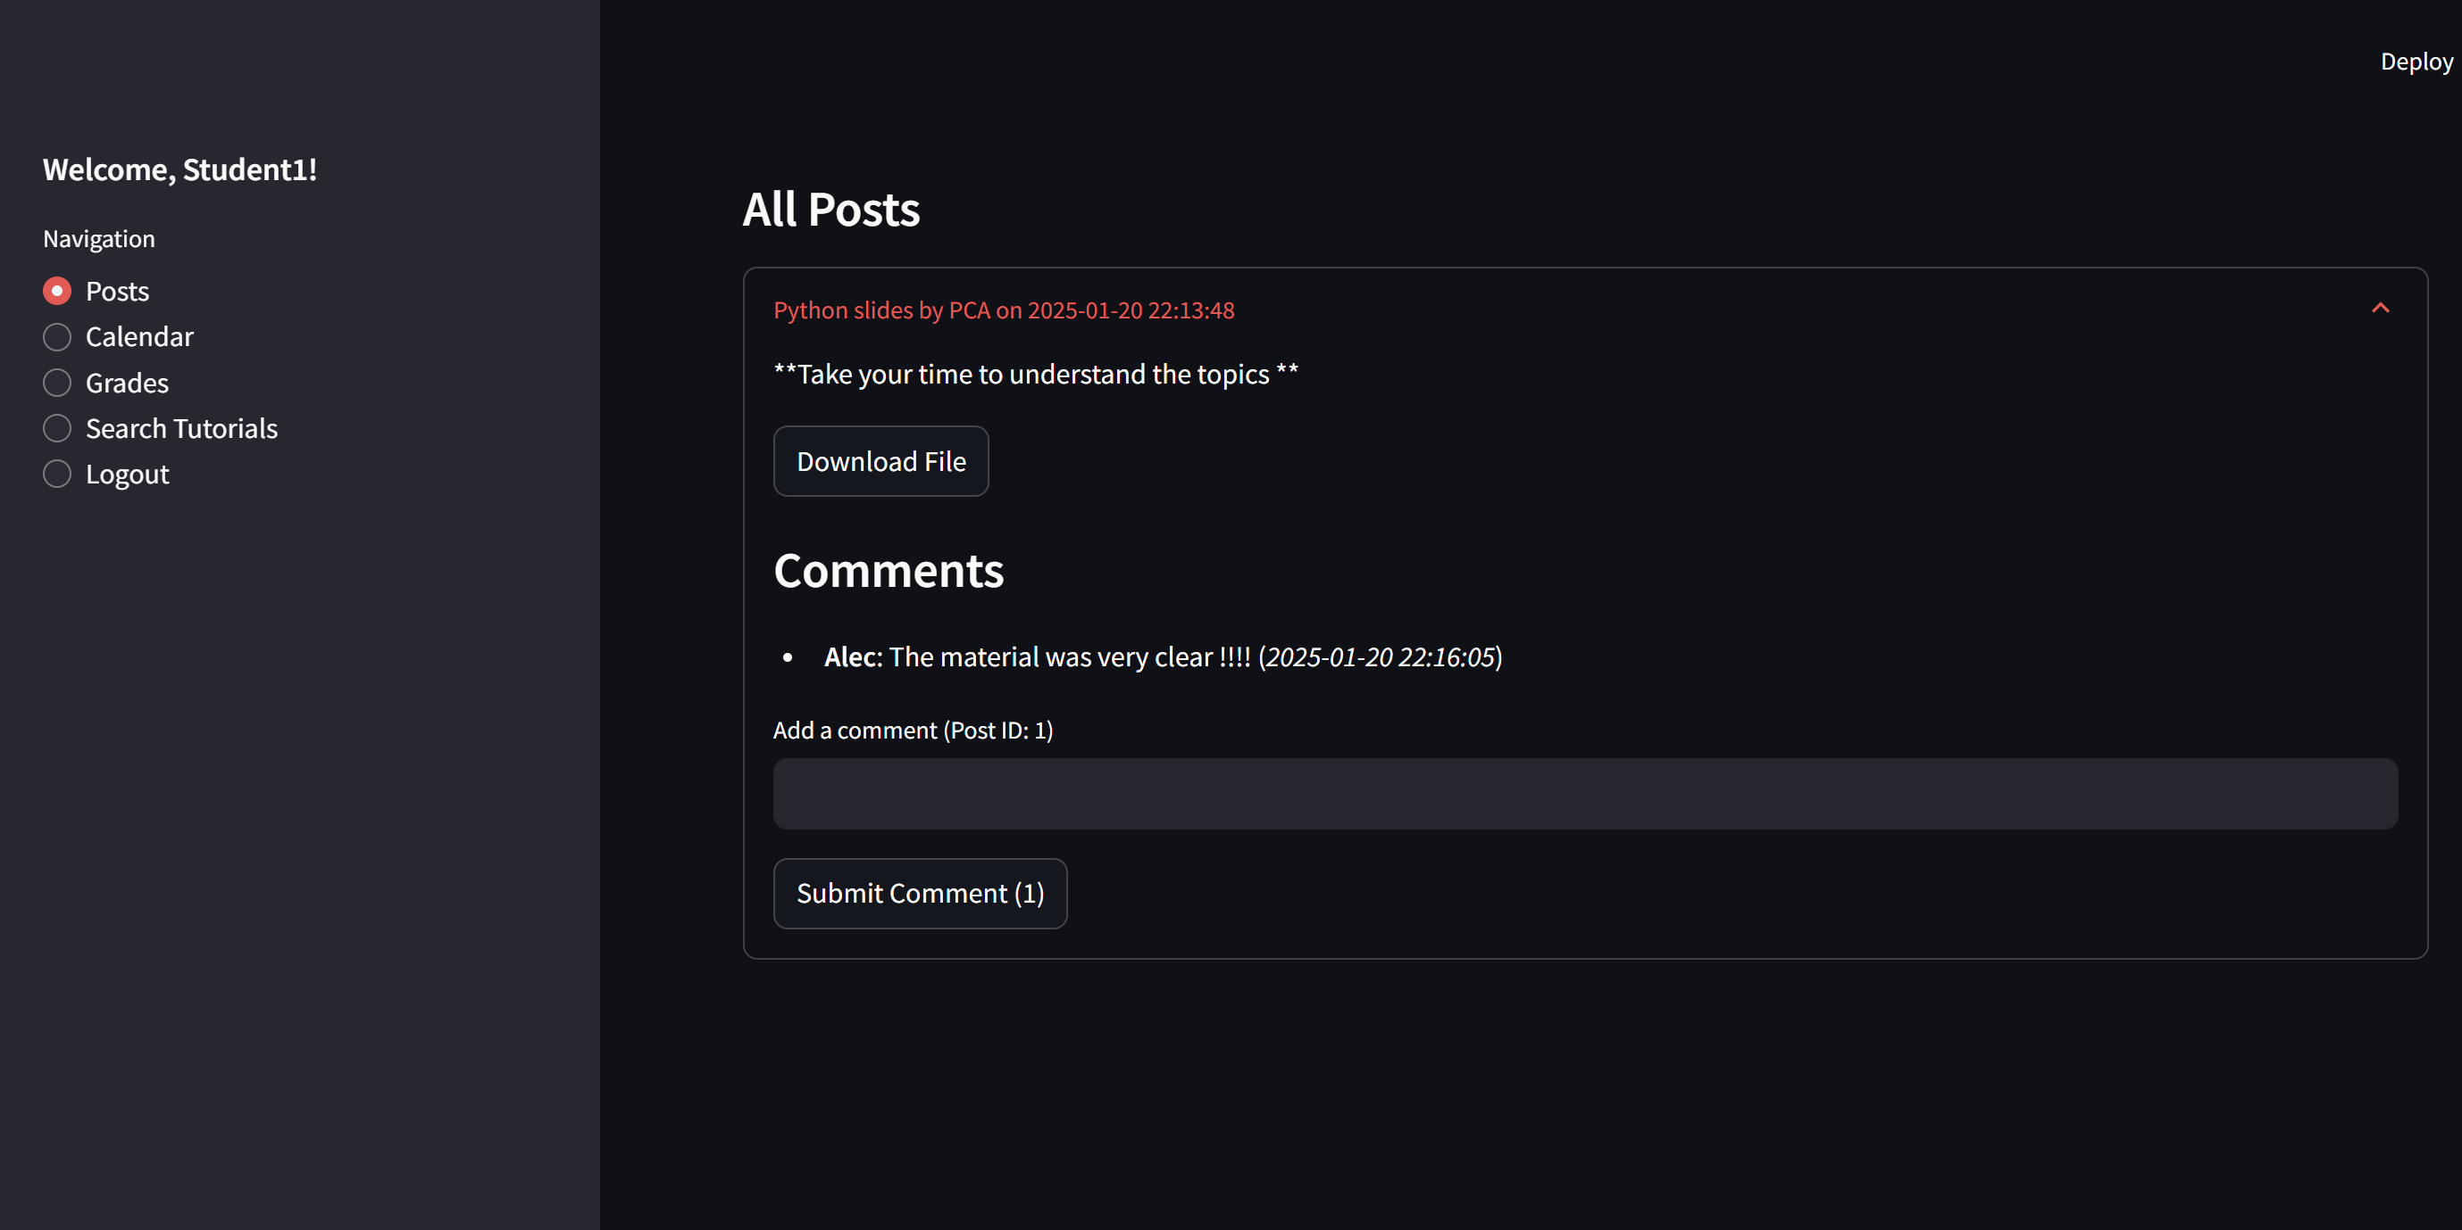
Dashboard and Post management in student’s account
PAGE

Slide 5
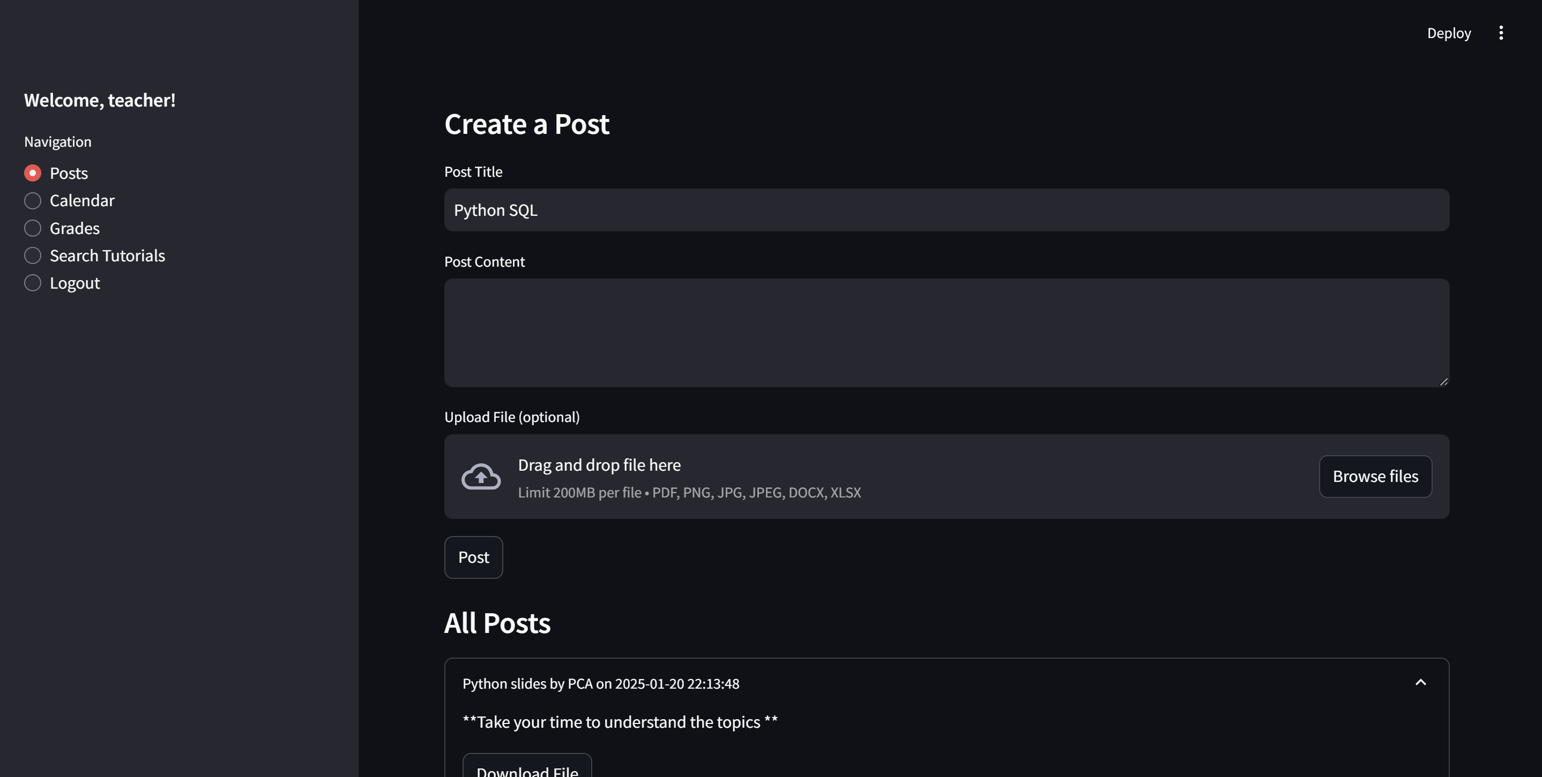
Teacher’s post section

Slide 6
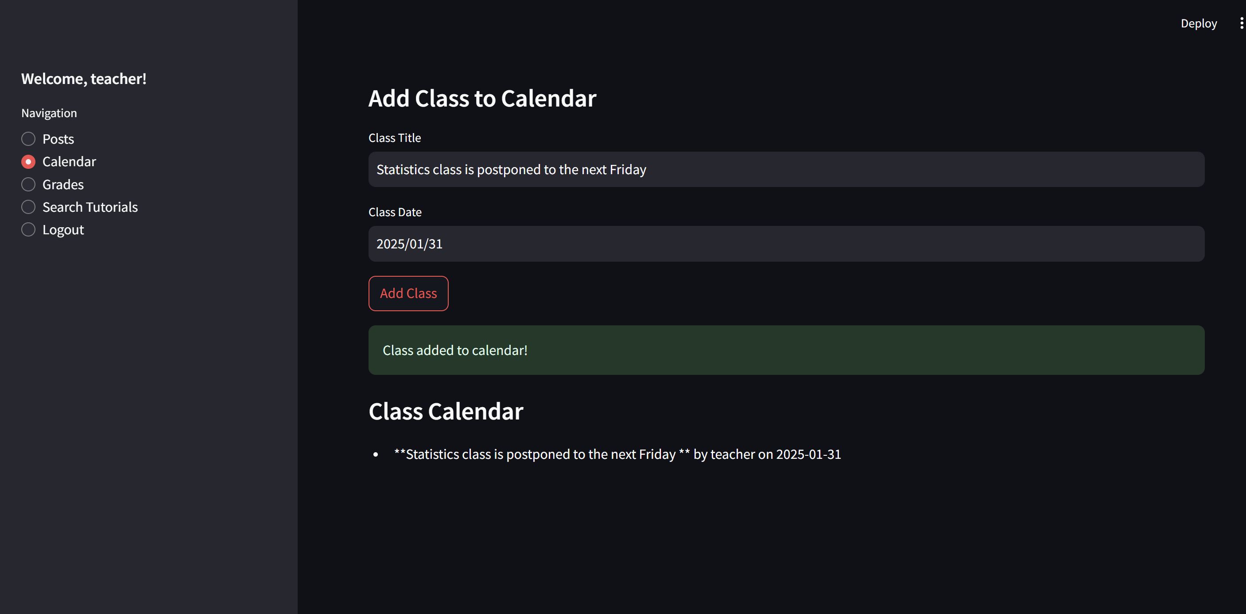
Teacher’s calendar section

Slide 7
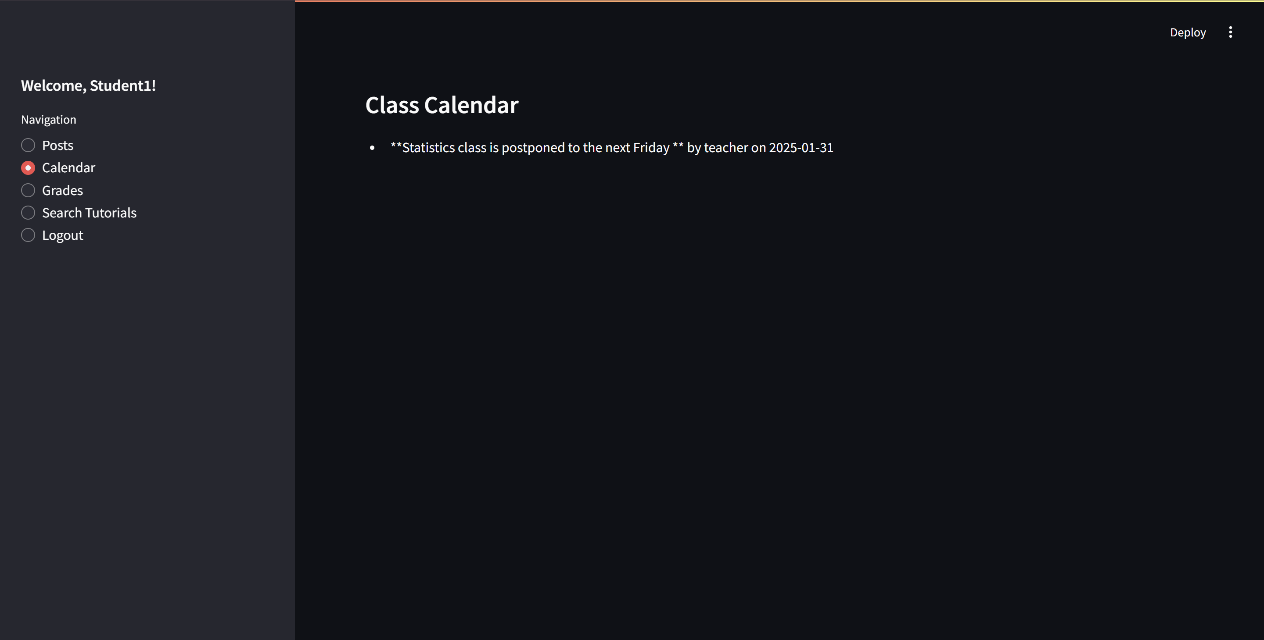
Teacher’s calendar section

Slide 8
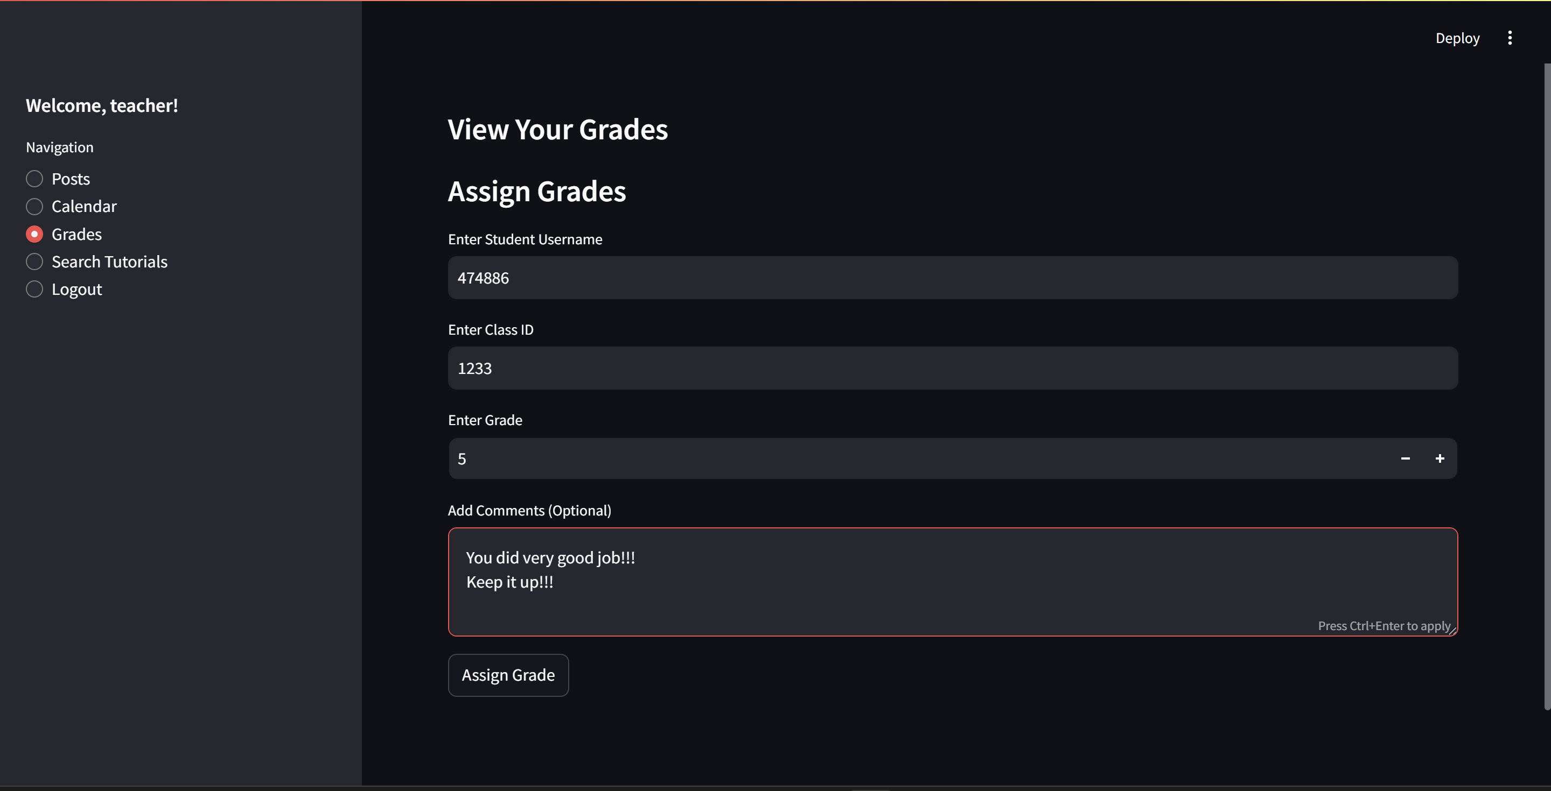
Grading section in teacher’s account

Slide 9
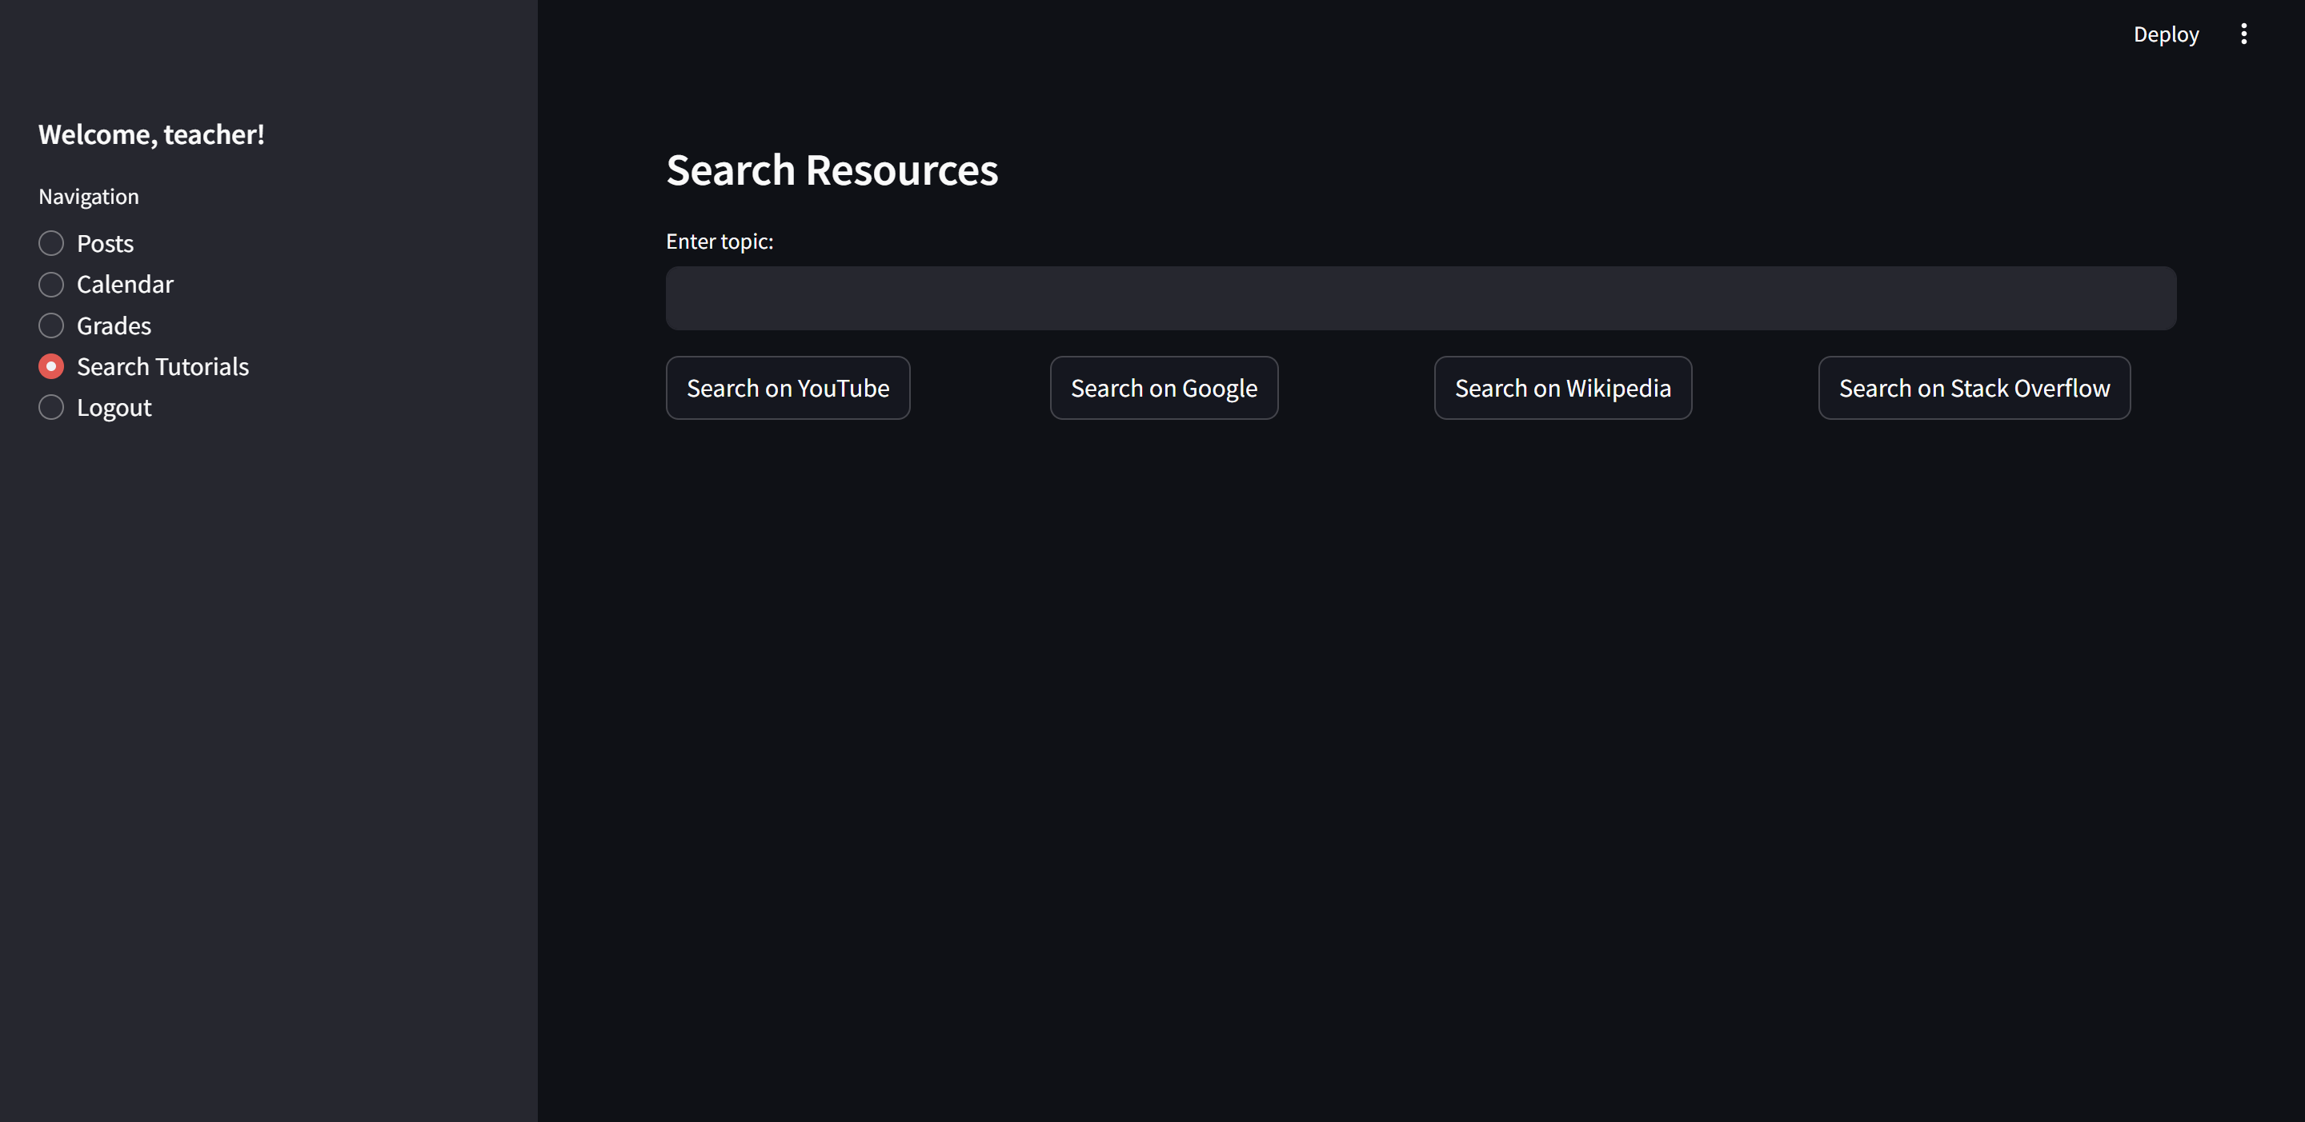
Resource search section

Slide 10
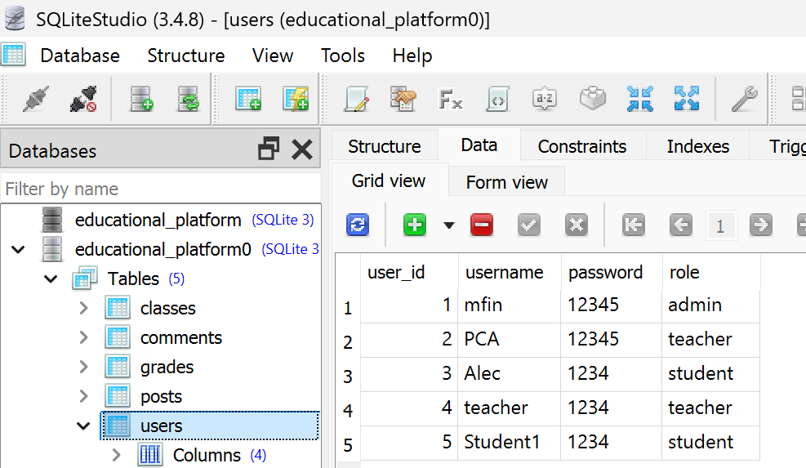
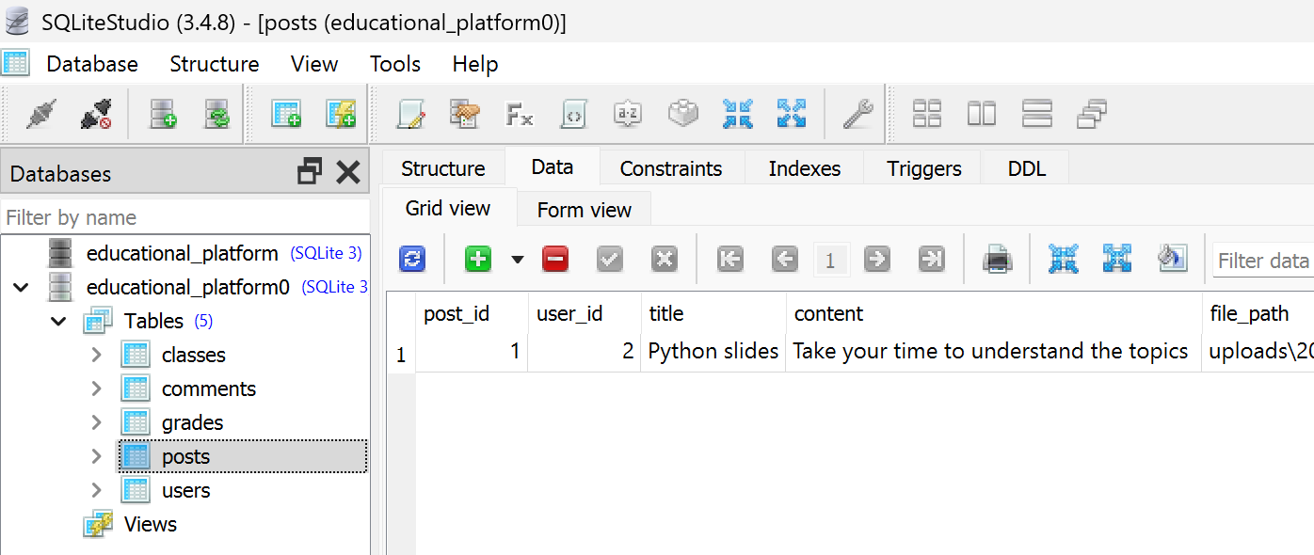
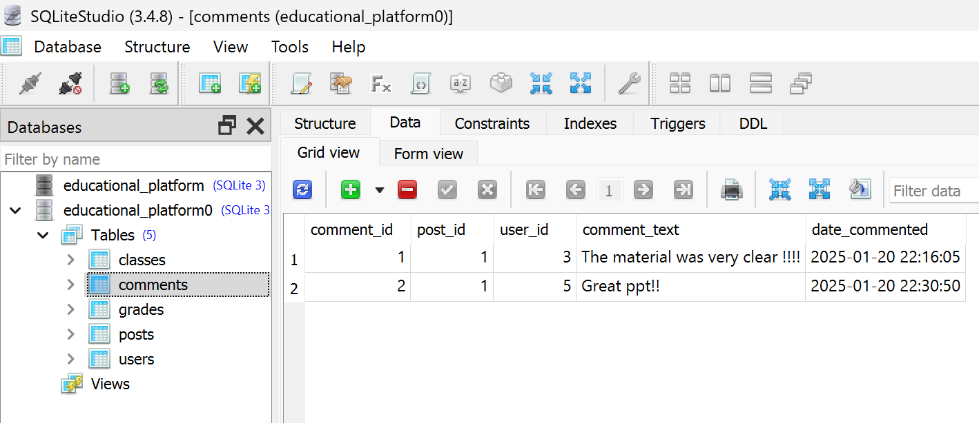
Database

Slide 11
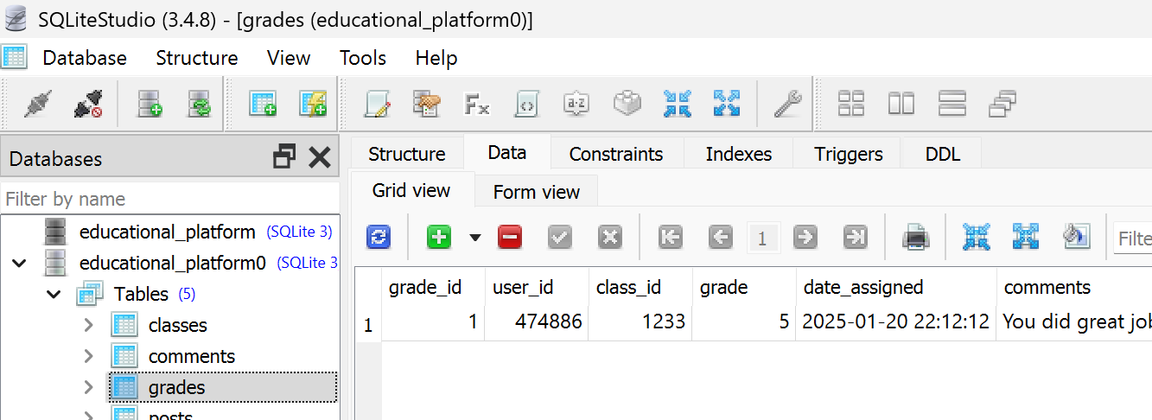
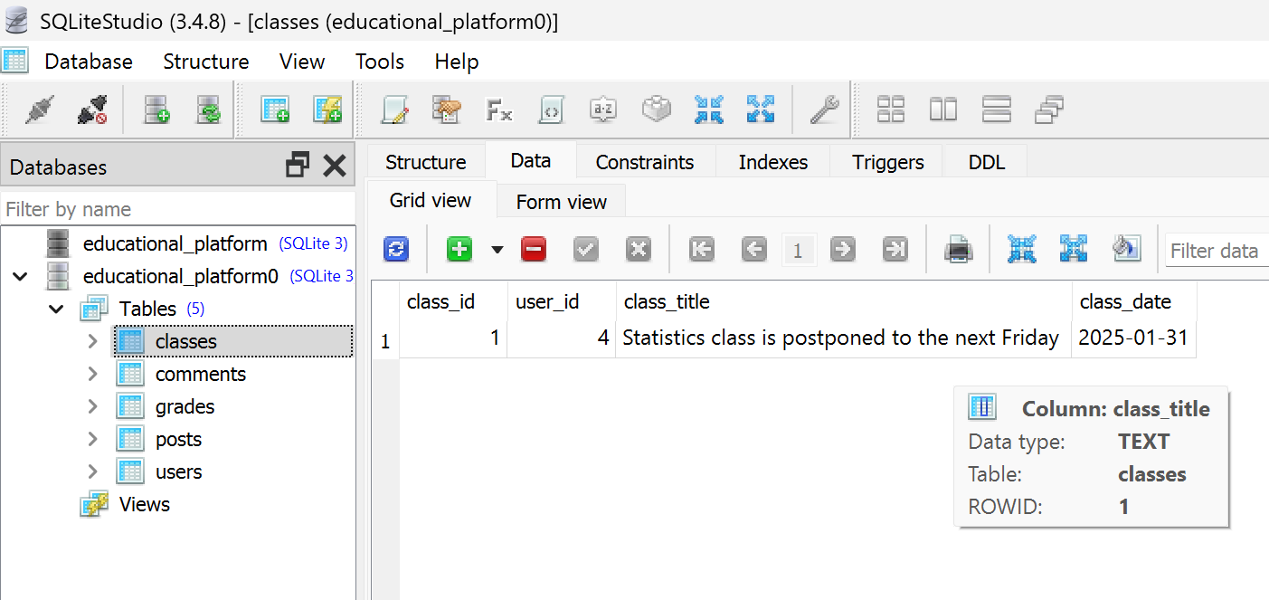
Database

Slide 12
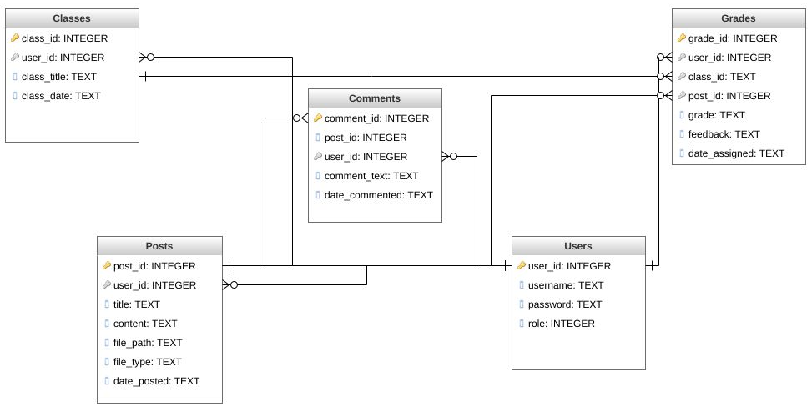
Database Schema

Slide 13

Thank You!

